Slide 1
Android Patient Tracker
Using Flutter & Firebase
By E.A.T

Slide 2
Flutter
Flutter is Google's portable UI toolkit for crafting beautiful, natively compiled applications for mobile, web, and desktop from a single codebase. Flutter works with existing code, is used by developers and organizations around the world, and is free and open source.
Same UI and Business Logic in All Platforms
Reduced Code Development Time
Increased Time-to-Market Speed
Similar to Native App Performance
Custom, Animated UI of Any Complexity Available
Own Rendering Engine
Simple Platform-Specific Logic Implementation
The Potential Ability to Go Beyond Mobile

Slide 3
Firebase
Google Firebase is a Google-backed application development software that enables developers to develop iOS, Android and Web apps. Firebase provides tools for tracking analytics, reporting and fixing app crashes, creating marketing and product experiment.
Firebase offers a number of services, including:
Analytics
Authentication
Cloud messaging
Realtime Database
Crashlytics
Performance
Test Lab

Slide 4
Introduction
We propose to develop an android application to aid in dispensary patient data management and viewing. The system is aimed to help doctors to enter as well as view patient history as well as other patient details. Our system is a standalone system that can be installed on doctor android phone to be used for further login. On installation the application allows a doctor to open application and enter the details of any patient (either by himself or through a nurse) that undertakes his service. The application allows doctors/nurses to insert various data fields regarding a patient including patient name, age, sex, medication provided, date of arrival, etc. The system saves this patient related data in the android phone. The doctor may now view this data as and when needed. The doctor may check the details whenever needed. The application allows doctors to view patients by their priority as a default sort.

Slide 5
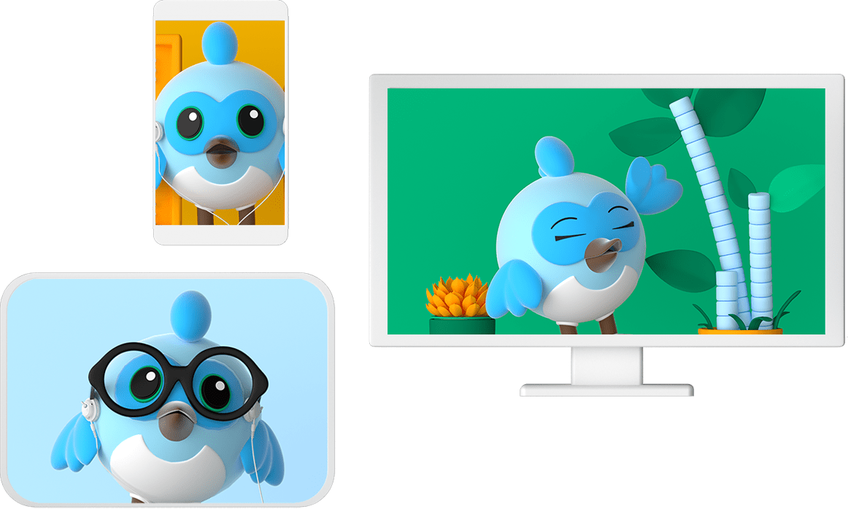
Features of Android Patient Tracker
Easy access for the doctors/nurses
Secure login
Historical Data Available
Remote Access for users
Saves time and human intervention
Flexible and secure to use

Slide 6
Benefits of Android Patient Tracker
User Friendly
Higher Security than traditional ways of storing data
Attractive UI
Accessible from anywhere
Reduced Paper Cost
Cost Effective app
Less chances of human error

Slide 7
Thank You
Hope you like what we created!
If you wanna contact us for any queries, reach us at -
tanveersingh0710@gmail.com
or
grewaleshandeep.01@gmail.com

